Slide 1
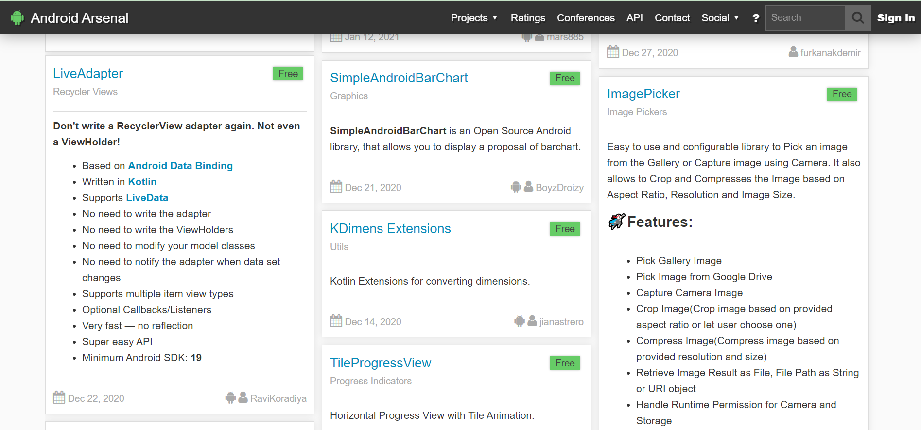

Slide 2
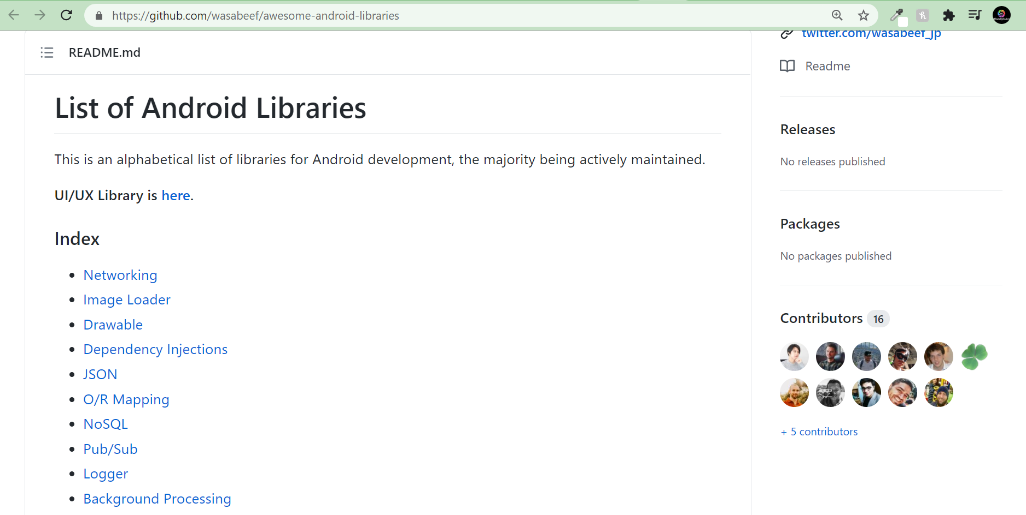
Notes:
https://github.com/wasabeef/awesome-android-libraries

Slide 3
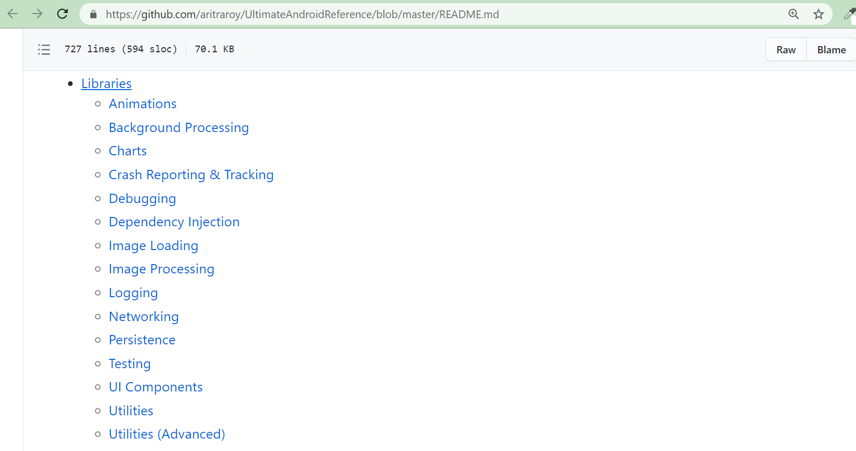
Notes:
https://github.com/aritraroy/UltimateAndroidReference/blob/master/README.md

Slide 4
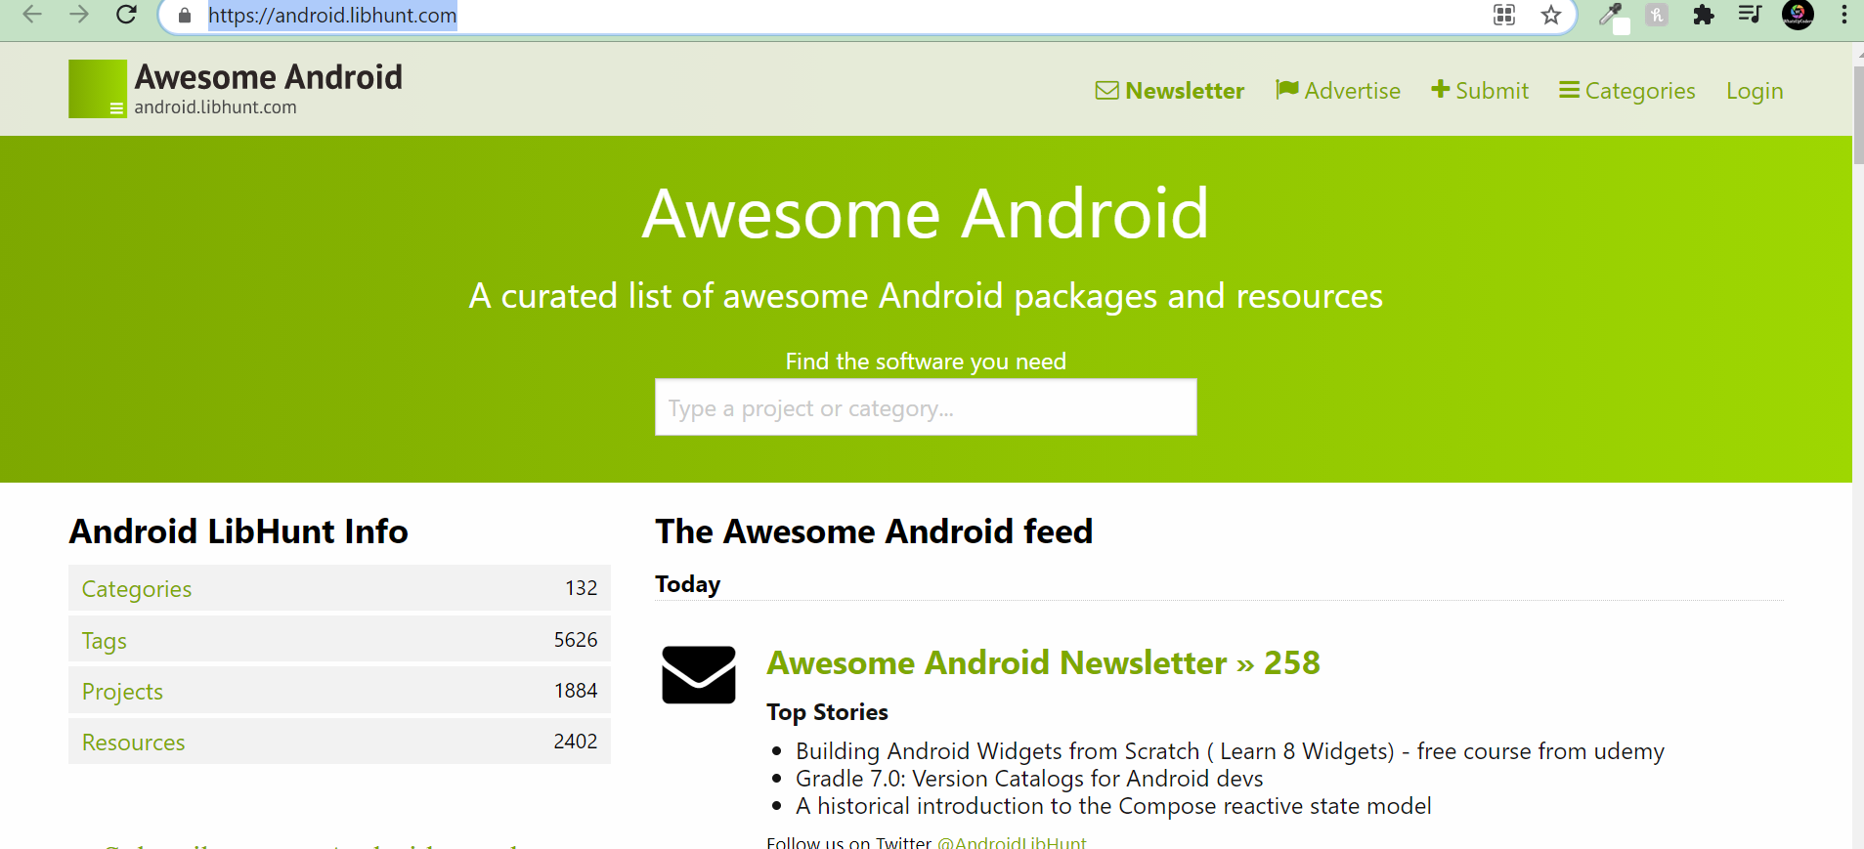
Notes:
https://android.libhunt.com/

Slide 5
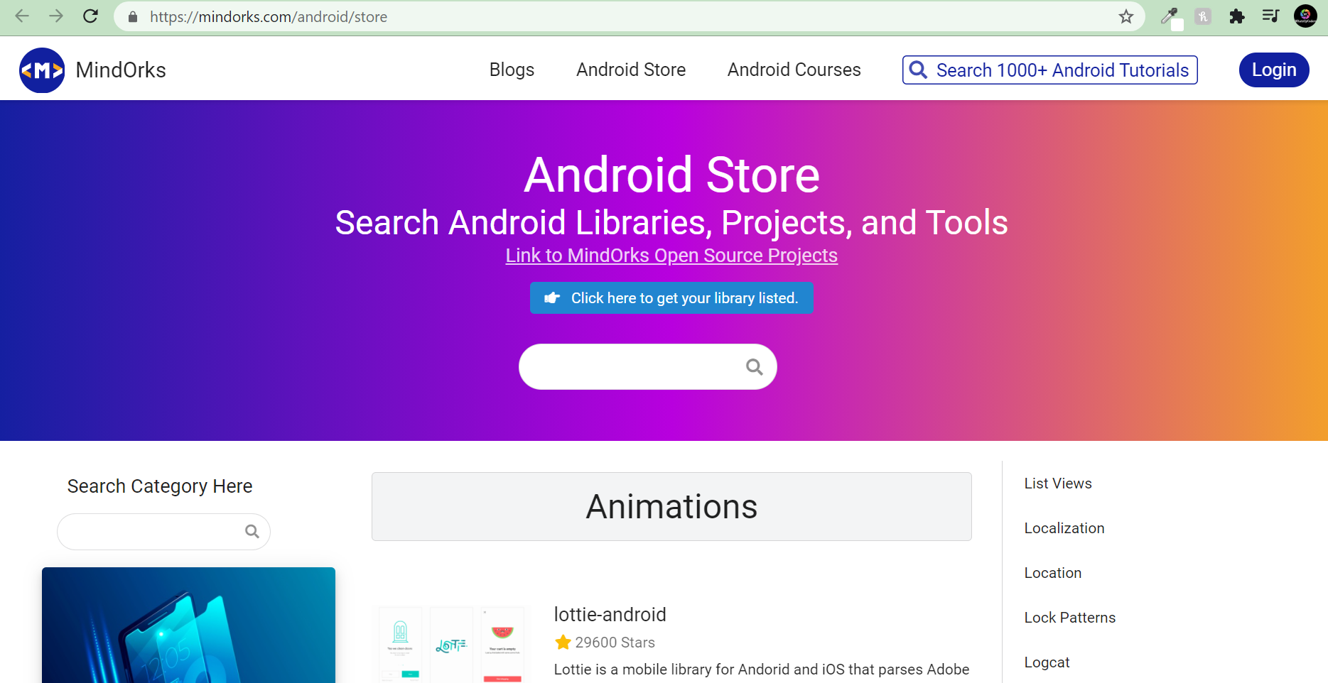

Slide 6
Pros using Third Party Libraries
Save Time
Modular Code
Pre -Tested

Slide 7
Cons using Third Party Libraries
Overuse
Security Issues
Support

Slide 8
Build your own Library

Slide 9
Thanks!

